Slide 1
Orbit Propagation to Determine Satellite’s Demise
Jacob Bailey
Gus Lee
Michael Lesnewski

Slide 2
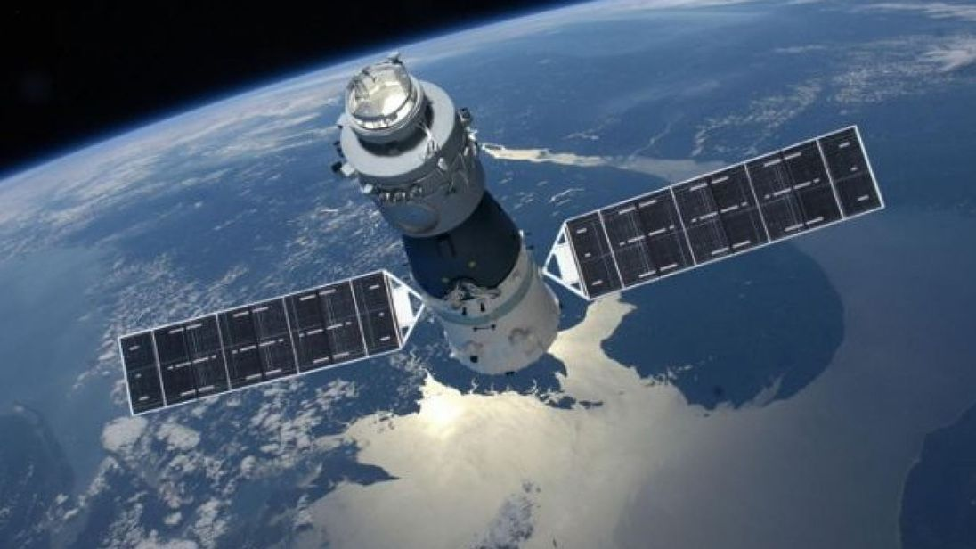
Problem Statement
Objective:
Propagate the orbit of the Tiangong 1 Chinese space station and estimate the lifetime of the space station using both numerical integration of the perturbed Keplarian equations of motion and the averaged Gauss variational equations.
The Tiangong 1 re-entered the Earth’s atmosphere on April (1-2) 2018.
Source: https://news.sky.com/story/chinese-space-lab-tiangong-1-re-enters-earths-atmosphere-11313548

Slide 3
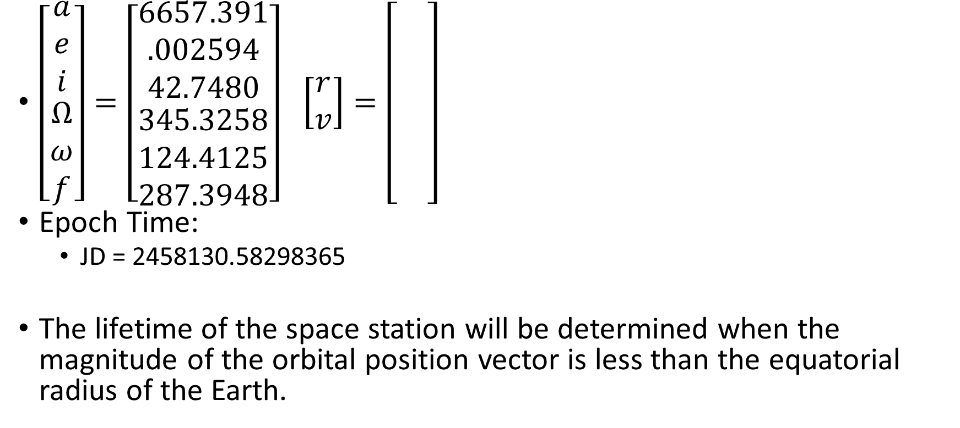
Initial Conditions for Orbit Propagation
$\left[\begin{matrix}\begin{matrix}a \\ e \\ i\end{matrix} \\ \begin{matrix}Ω \\ ω \\ f\end{matrix}\end{matrix}\right]=\left[\begin{matrix}\begin{matrix}6657.391 \\ .002594 \\ 42.7480\end{matrix} \\ \begin{matrix}345.3258 \\ 124.4125 \\ 287.3948\end{matrix}\end{matrix}\right]$ $\left[\begin{matrix}r \\ v\end{matrix}\right]=\left[\begin{matrix}\begin{matrix} \\ \\ \end{matrix} \\ \begin{matrix} \\ \\ \end{matrix}\end{matrix}\right]$
Epoch Time:
JD = 2458130.58298365
The lifetime of the space station will be determined when the magnitude of the orbital position vector is less than the equatorial radius of the Earth.

Slide 4
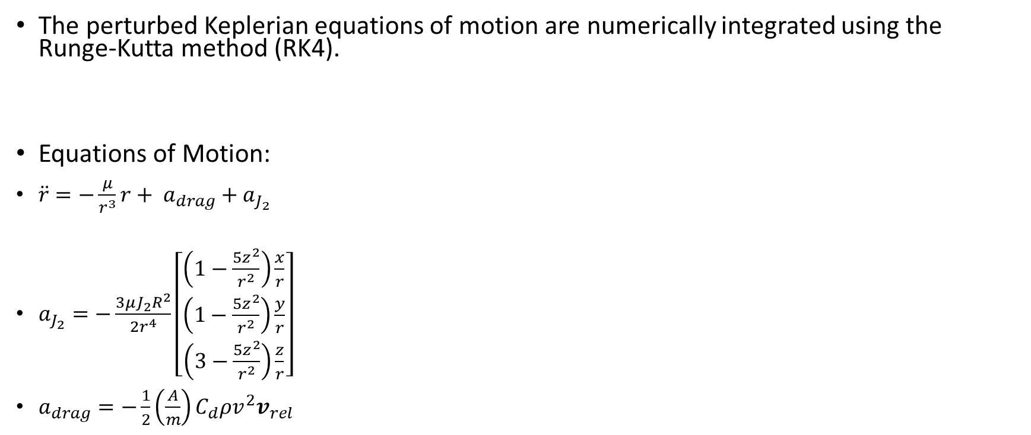
Orbit Propagation using Numerical Integration
The perturbed Keplerian equations of motion are numerically integrated using the Runge-Kutta method (RK4).
Equations of Motion:
$\ddot{r}=−\frac{μ}{r^{3}}r+ a_{drag}+a_{J_{2}}$
$a_{J_{2}}=−\frac{3μJ_{2}R^{2}}{2r^{4}}\left[\begin{matrix}\left(1−\frac{5z^{2}}{r^{2}}\right)\frac{x}{r} \\ \left(1−\frac{5z^{2}}{r^{2}}\right)\frac{y}{r} \\ \left(3−\frac{5z^{2}}{r^{2}}\right)\frac{z}{r}\end{matrix}\right]$
$a_{drag}=−\frac{1}{2}\left(\frac{A}{m}\right)C_{d}ρv^{2}v_{rel}$

Slide 5
Results: Numerical Integration

Slide 6

Orbit Propagation using Gauss Variational Equations
Asd
Equations of Motion:
$\dot{\dot{\overline{a}}=−\left(\frac{A}{m}\right)C_{d}na^{2}p_{a}\left\{I_{0}\left(ν\right)+2eI_{1}\left(ν\right)+\frac{3}{4}e^{2}\left[I_{0}\left(ν\right)+I_{2}(ν)\right]\right\}}$
$\dot{\overline{e}}=−\left(\frac{A}{m}\right)C_{d}na\left(1−e^{2}\right)p_{a}\left\{I_{1}\left(ν\right)+\frac{1}{2}e\left[I_{0}\left(ν\right)+I_{2}(ν)\right]+\frac{1}{8}e^{2}\left[3I_{1}\left(ν\right)+I_{3}(ν)\right]\right\}$
$\dot{\overline{Ω}}=−\frac{3J_{2}R^{2}n}{2p^{2}}\cos{i}$
$\dot{\overline{ω}}=\frac{3J_{2}R^{2}n}{4p^{2}}\left(5\cos^{2}{i}−1\right)$

Slide 7
Results: Gauss Variational Equations

Slide 8
Conclusion

